Slide 1
American Manchester Terrier Club Breed Seminar

Slide 2
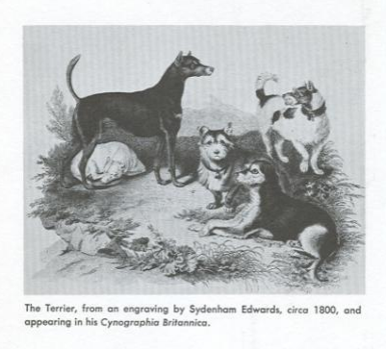
History and Background
Oldest of the identifiable Terrier Breeds
1570: Dr. Caius Encyclopedia of Dogs mentioned Black & Tan Terrier as rougher in coat & shorter on leg
Early 1800s: The Dog in Health and Disease, by J.A.Walsh, Devoted a full chapter to the
Black and Tan terrier, giving them recognition as an established breed.
Mr. Walsh’s description might serve well today:
Smooth coated
Nose-long, tapering
Skull-narrow and flat
Eyes-small and bright
Chest-rather deep than wide
Color-ONLY black and tan

Slide 3
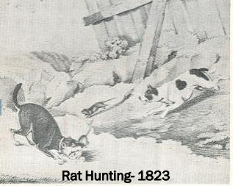
Europe in the Early 1800’s: - Cities had poor sanitation - Rats became a health menace - Rat killing became a popular sport JOHN HULME- enthusiastic devotee of both the sports of rat killing and rabbit coursing bred a Whippet to a cross- bred terrier to develop, for both sports, one breed of dog. Perhaps the Whippet influence explains the unusual topline of the Manchester Terrier still required today. This cross proved so successful that it was repeated, resulting in the establishment of a definite type. Thus, the development of the Manchester Terrier came about as a direct result of the popularity of rat killing. 1827- The celebrated “Billy”, a dog with decided Manchester features, was said to have killed 100 rats in 12 minutes, in a rat pit. By 1860- the Manchester district became the breed center for these “ rat terriers” and the name Manchester Terrier surfaced.
English History

Slide 4
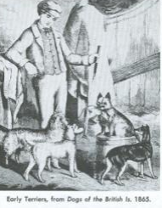
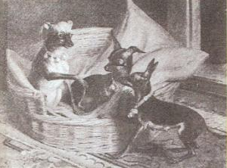
The Breed developed a fighting spirit that made them equally handy in the Rat pit or a hedge row: They could tackle an opponent twice their size, with silent determination! They were often called the “Gentleman’s Terriers” because of their dauntless spirit. Ears were cropped to reduce the risk of having them torn in frequent scraps. This also enhanced the sharp appearance of the expression. When rat killing became illegal in England, rat pits were supplanted by the dining halls of public inns, which were all infested with rats. Many Inns kept their own kennel. When the tap rooms closed, who do you think took command? The black & tan rat killing machines proved worth 100 fold to the Inn keeper
English History
Smaller specimens gained appeal, leading to a concentrated effort to reduce size further, at any cost. They developed apple dome heads and size diminished to 2 ½ lbs. They became frail and sickly.
Two distinct breeds developed with completely different types. The smaller specimens became the English Toy (Black & Tan) Terrier while the larger ones remained as the Manchester Terrier. These two breeds remain separate in England today .

Slide 5
1886 Just two years after the A.K.C. was organized, the first Black & Tan Terrier was registered in the stud book 1887 The first Manchester Terrier was registered 1923 The Manchester Terrier Club of America was recognized (Standard Variety) 1934 Black & Tan Toy Terrier changed to Toy Manchester Terrier 1938 The American Toy Manchester Terrier Club was organized 1952 The MTCA was without organized breed representation 1958 To the credit of the ATMTC, the two breeds were combined as one with two varieties (Standard & Toy) with the formation of the American Manchester Terrier Club (AMTC)
American History

Slide 6
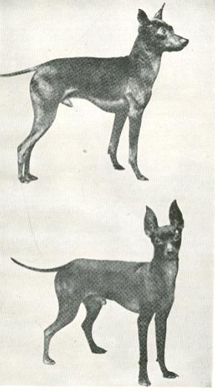
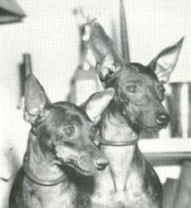
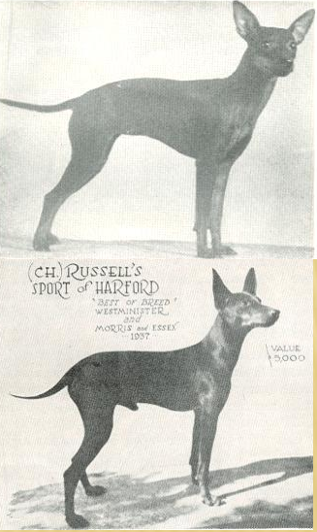
Toys 1936 - 1945
Note the difference from todays Toys:
Lack of substance
Ears
Eyes
Skulls
Muzzles

Slide 7
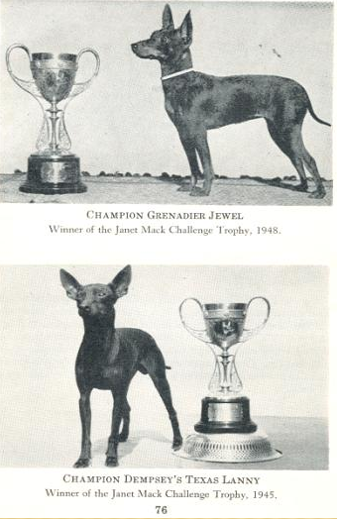
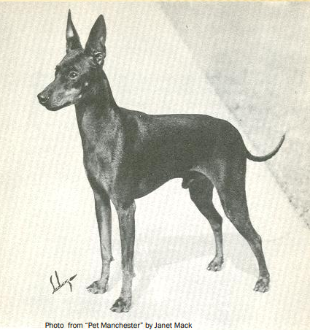
Toys 1945 - 1955

Slide 8
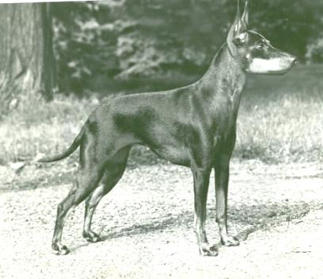
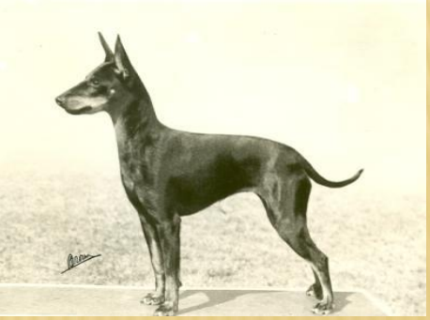
Toys 1960 - 1970
Note the improvement
Substance
Head
Eye
Muzzle
Ears

Slide 9
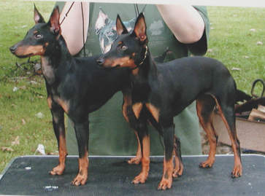
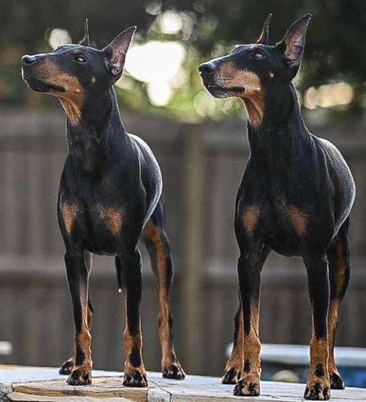
General Appearance
A small black short coated dog with distinctive rich
mahogany markings and a taper style tail.
In structure, the Manchester presents a sleek,
sturdy yet elegant look and has a wedge shaped long
and clean head with a keen, bright, alert expression.
The smooth, compact, muscular body expresses great power and agility enabling the Manchester to kill vermin and course small game.
Except for size and ear options, there are no differences between the Standard and Toy varieties of the Manchester Terrier. The Toy variety is a diminutive version of the Standard variety.

Slide 10
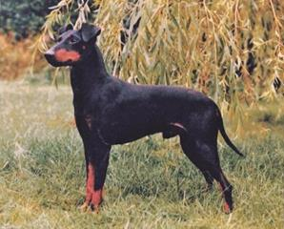
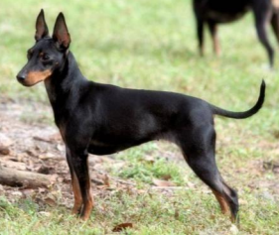
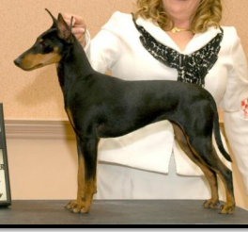
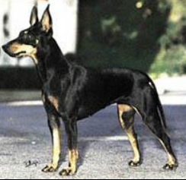
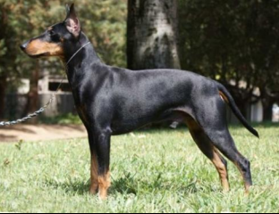
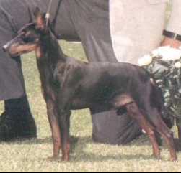
General Appearance

Slide 11
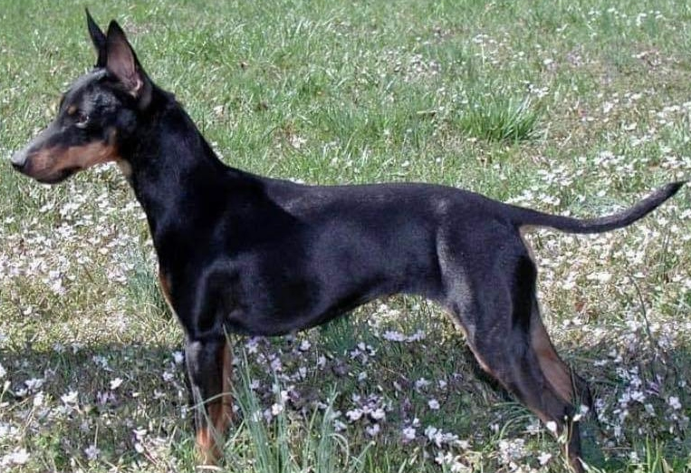
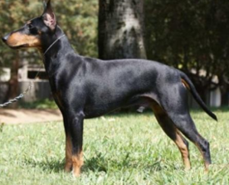
The Toy variety shall not exceed 12 pounds. The Standard variety shall be over 12 pounds and not exceeding 22 pounds. The Manchester Terrier, overall, is slightly longer than tall. The height, measured vertically from the ground to the highest point of the withers, is slightly less than the length, measured horizontally from the point of the shoulders to the rear projection of the upper thigh. The bone and muscle of the Manchester Terrier is of sufficient mass to ensure agility and endurance. The toy variety over 12 pounds shall be excused. Disqualification: Standard Variety - Weight over 22 pounds.
Size, Proportion, Substance

Slide 12
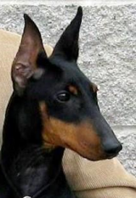
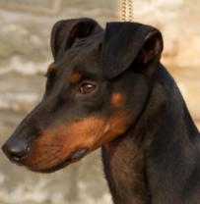
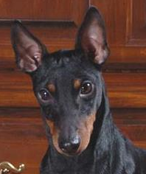
Head
The Manchester Terrier has a keen and alert expression. The nearly black, almond shaped eyes are small, bright and sparkling. They are set moderately close together slanting upwards on the outside. The eyes neither protrude nor sink in the skull. Eye lid and rim pigmentation is black.
Correct ears for the Standard variety are the naturally erect ear, the cropped ear or the button ear. No preference is given to any of the ear types.
The naturally erect ear and button ear are wider at the base tapering to pointed tips and carried well up on the skull. Cropped ears are long, pointed and carried erect. The only correct ear for the Toy variety is the naturally erect ear. They are wider at the base tapering to pointed tips and carried well up on the skull.
The head is long, narrow, tight skinned and almost flat with a slight indentation up the forehead. It resembles a blunted wedge in frontal and profile views. The muzzle and skull are equal in length. There is a visual effect of a slight stop as viewed in profile. The muzzle is well filled under the eyes with no visible cheek muscles. The underjaw is full and well defined and the nose is black. Tight black lips lie close to the jaw. The bite is a true scissors bite. Level bite is acceptable. The jaws are powerful with full and proper dentition. The teeth are white and strongly developed.
Wide, flaring, blunt tipped or “bell” ears are a serious fault for both varieties.
Disqualification: Toy Variety – Cropped or button ears.

Slide 13
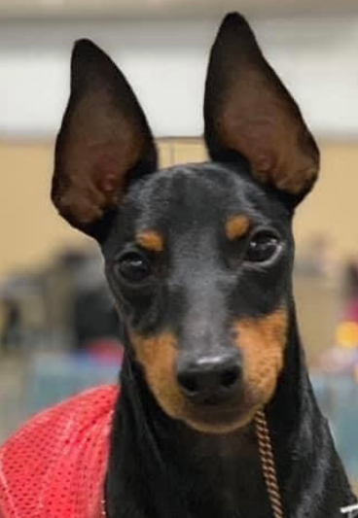
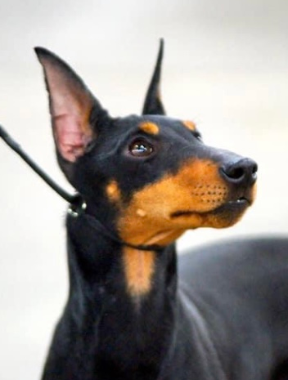
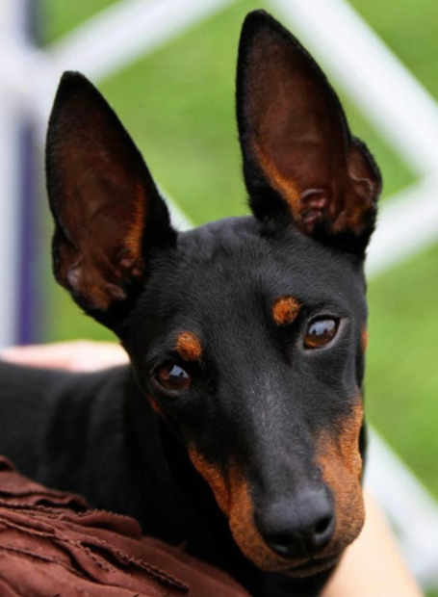
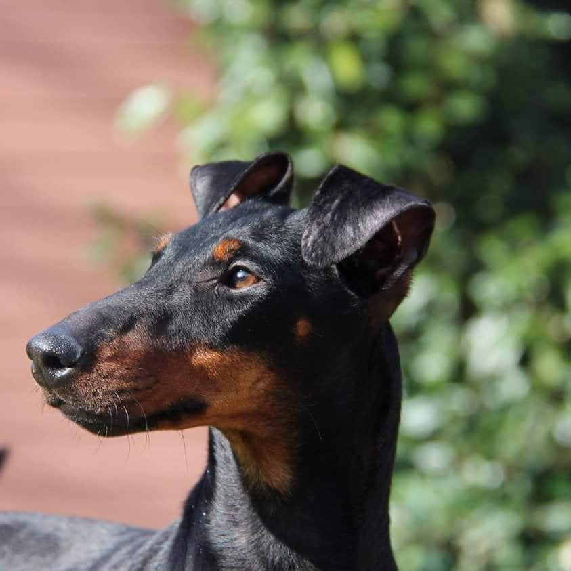
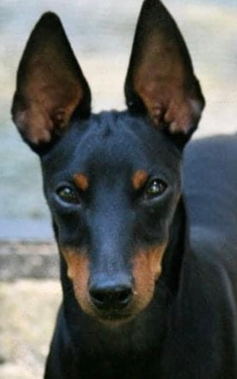
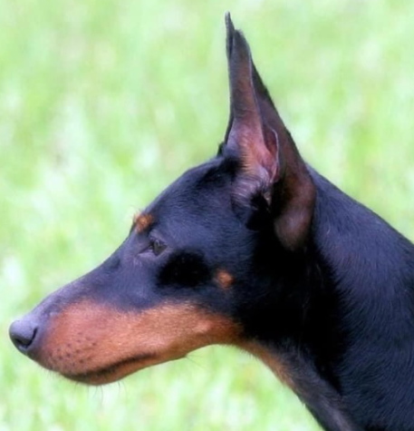
Good examples
of correct heads

Slide 14
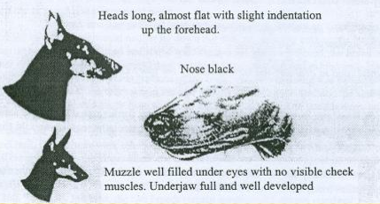
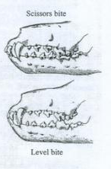
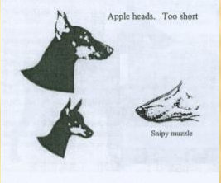
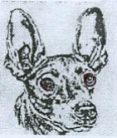
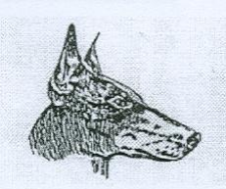
Review: Head (Skull and Eyes)
Skull & Muzzle equal in length
Skull & Muzzle Faults
Skull too round, muzzle too short or thick and Lack of Underjaw
Resembles blunted wedge in frontal & profile view
Scissor bite preferred
Level bite acceptable
Eyes- Nearly black, almond shaped
Small, bright, sparkling
Set close together
Slanting upwards on outside
Neither protrude nor sink in skull
Rim pigmentation black
Eye Faults
Rather wide apart
Too large, too round
Too light in color

Slide 15
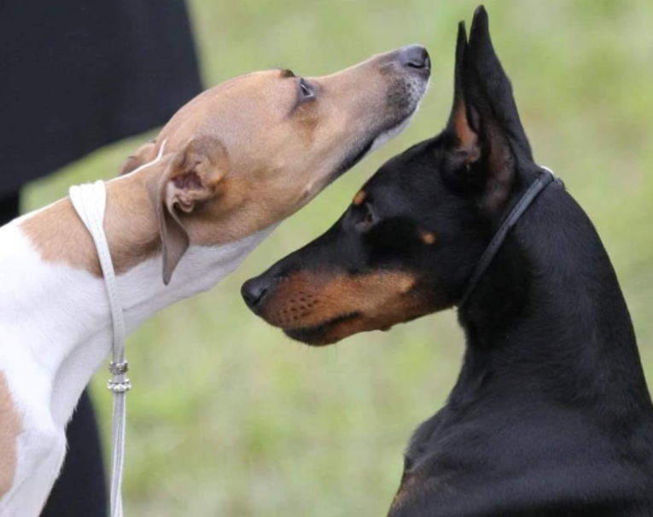
Notice the difference in head types in this neat picture

Slide 17
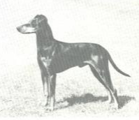
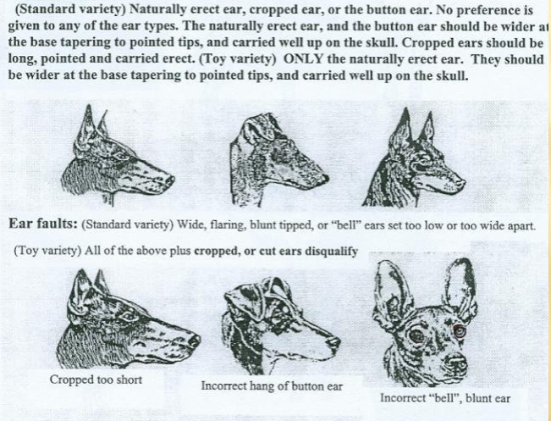
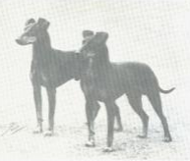
Review-Head (Ears)

Slide 18
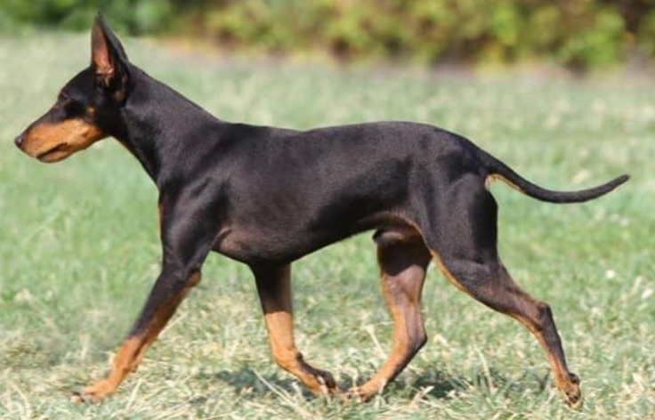
Neck, Topline, Body
The slightly arched neck is slim, graceful and of moderate length. It gradually becomes larger as it approaches and blends smoothly with the sloping shoulders.
The topline shows a slight subtle arch over the robust loins falling slightly to the tail set. While standing or in motion, a flat or roached back is a serious fault for both varieties. The chest is narrow between the legs and deep in the brisket.
The forechest is moderately defined. The ribs are well sprung, flattened in the lower end to permit clearance of the forelegs.
The underline is tucked up extending in an arched line from the deep
brisket.
The taper style tail is moderately short reaching no further than
the hock joint. It is set on at the end of the croup being thicker
where it joins the body. The tail tapers to a point carried no higher
than the back.
While standing or in motion, a flat or roached back is a
serious fault for both varieties.

Slide 19
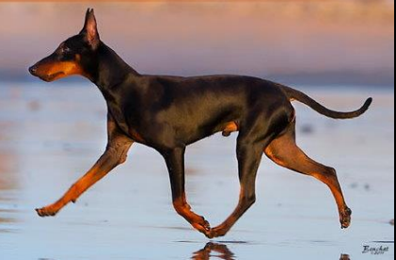
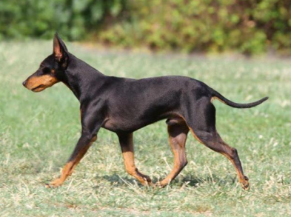
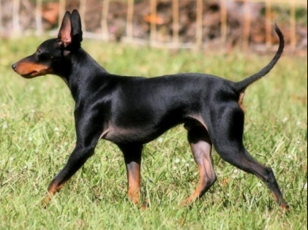
Slight Subtle Arch

Slide 20
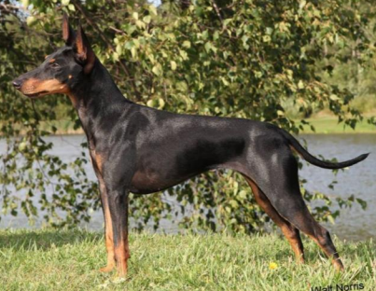
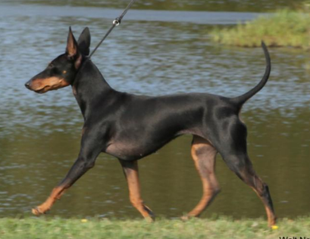
Why judged moving?

Slide 21
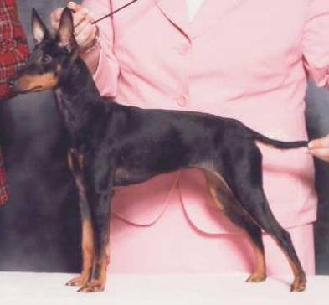
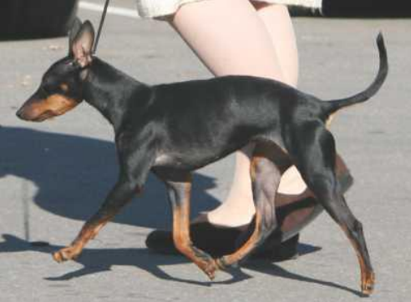
Why judged moving?

Slide 22
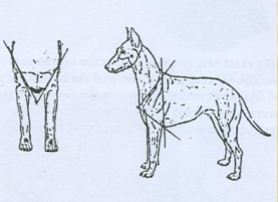
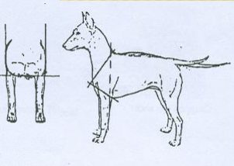
Review: Neck, Body, Topline

Slide 23
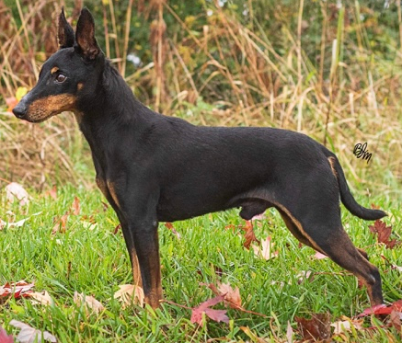
Forequarters
The shoulder blades and the upper arm are relatively the same length. The distance from the elbow to the withers is approximately the same as the distance from the elbow to the ground. The elbows lie close to the brisket.
The shoulders are well laid back. The forelegs are straight of proportionate length and placed well under the brisket.
The pasterns are almost perpendicular.
Dew claws may be removed.
The front feet are compact and well arched. The two middle toes are slightly longer than the others. The pads are thick and toenails are jet black.

Slide 24
Forequarters

Slide 26
Hindquarters
The thigh is muscular with the length of the upper and lower thighs being approximately equal.
The stifle is well turned.
The hindquarters are in balance with the well laid back shoulders.
The hocks are well let down. Dew claws may be removed.
The hind feet are shaped like those of a cat with thick pads and jet-black nails.

Slide 28
Coat
The coat is smooth, short, dense, tight and glossy.
The coat is jet black with rich mahogany tan which does not blend into each other, but abruptly form clear, well-defined lines of color.
Faults & DQ: White on any part of the coat is a serious fault, and a disqualification whenever the white forms a patch or stripe measuring as much as one half inch at its longest dimension. Any color other than black and tan shall be disqualified.
Soundness and type supercede color and markings.

Slide 29
Color and Markings
There is a very small tan spot over each eye and a very small tan spot on each cheek. On the head, the muzzle is tanned to the nose.
The nose and nasal bone are jet black.
The tan extends under the throat ending in the shape of the letter V.
The inside of the ears are partly tan.
There are tan spots, called “rosettes” on each side of the chest above the front legs. These are more pronounced in puppies than in adults.
There is a black “thumb mark” patch on the front of each foreleg at the pastern. The remainder of the foreleg is tan to the carpus joint.
There is a distinct black “pencil mark” line running lengthwise on the top of each toe on all four feet.
Tan on the hind leg should continue from the penciling on the toes up the inside of the legs to a little below the stifle joint.
The outside of the hind legs is black.
There is tan under the tail and on the vent but only of such size as to be covered by the tail.

Slide 30
Color and Markings

Slide 31
Thumbprints

Slide 32
Color Faults
Breeching on the (outer) rear leg
Smuttiness in the muzzle

Slide 33
Gait
The gait is free and effortless with good reach of the forequarters.
Rear quarters have strong, driving power to match the front reach.
Hocks fully extend. Each rear leg moves in line with the foreleg of the same side, neither thrown in nor out.
When moving at a trot, the legs converge toward the center of gravity of the dog.

Slide 34
Gait

Slide 35
Temperament
The Manchester Terrier is neither aggressive nor shy. He is keenly observant, devoted yet discerning.
Not being a sparring breed, the Manchester Terrier is generally friendly with other dogs.
Excessive shyness or aggressiveness is considered a serious fault.

Slide 36
Faults & Disqualifications
Faults:
Toy Variety: over 12 pounds shall be excused
Both Varieties:
Wide, flaring, blunt tipped or “bell” ears.
Flat or roached back while standing or in motion.
Excessive shyness or aggressiveness.
White on any part of the coat.
Disqualifications:
Standard Variety: Weight over 22 pounds
Toy Variety: Cropped or button ears
Both Varieties:
White on any part of the coat whenever the white forms a patch or stripe measuring as much as one half inch at its longest dimension
Any color other than black and tan

Slide 37
Class: Head

Slide 38
Class: Topline

Slide 39
Class: Bodies

